Slide 1
控制流劫持及 控制流完整性
第2讲 软件安全（1）

Slide 2
大纲
控制流劫持攻击
防御方法简介
Return to libc及ROP
控制流完整性（CFI）

Slide 3
控制流劫持攻击
攻击者目标:
获得目标机器的控制权
通过劫持应用程序的控制流，在目标机器上执行任意的攻击代码
攻击实例
缓冲区溢出攻击
格式化字符串漏洞及利用
http://phrack.org/issues/49/14.html

Slide 4
函数栈
Larger memory addresses
void main()
{ func(1,2,3);
}
void func(int a, int b, int c)
{ char buffer1[5];
char buffer2[10];
}
函数调用: push
Parameters, current %EIP as return address, saved frame pointer, local vars
Stack pointer
c:3
b:2
a:1
RET
Stack
growth
ebp
buf1
buf2
Smaller memory addresses
Stack pointer

Slide 5
函数栈
void main()
{ func(1,2,3);
}
void func(int a, int b, int c)
{ char buffer1[5];
char buffer2[10];
}
函数返回: pop
Activation record, update frame pointer using ebp, update %EIP using RET
Stack pointer
c:3
b:2
a:1
Stack pointer
RET
Stack
growth
Stack pointer
ebp
Stack pointer
buf1
buf2
Stack pointer

Slide 6
栈帧
Larger memory addresses
parameters
return address
Stack
growth
saved frame pointer
local variables
SP
Smaller memory addresses

Slide 7
缓冲区溢出
假设服务器程序包含以下函数: void func(char *str) { char buf[128];
strcpy(buf, str); do-something(buf); }
当函数被调用时，堆栈中数据如图所示:
str
RET
ebp
buf
stack pointer

Slide 8
缓冲区溢出
假设服务器程序包含以下函数: void func(char *str) { char buf[128];
strcpy(buf, str); do-something(buf); }
当函数被调用时，堆栈中数据如图所示:
如果字符串 *str大小为136字节
执行函数strcpy后，栈中数据如图所示:
str
RET
*str
ebp
buf
stack pointer

Slide 9
栈利用(stack exploit)
code for P
问题: 函数strcpy()没有对字符串的范围进行检查
假设执行函数strcpy后，栈中数据如图所示：
当函数func()退出时，程序P将会执行，攻击者获得shell
注意: 攻击代码在栈中执行
str
RET
RET
Program P: exec(“/bin/sh”)
ebp
*str
buf
stack pointer

Slide 10
许多不安全的libc函数
strcpy (char *dest, const char *src)
strcat (char *dest, const char *src)
gets (char *s)
scanf (const char *format, … )
“安全” 版本 strncpy(), strncat()也是不安全的
如：strncpy()函数不能保证用空字符‘\0’终止目标字符串
更安全：strlcpy、strcpy_s (Windows)

Slide 11
利用缓冲区溢出
假设web服务器使用攻击者提供的URL来调用函数func()
攻击者发送一个200字节的URL，获取Web服务器shell
攻击前提条件:
程序P不应包含’\0'字符
溢出应该保证在函数func()退出之前程序不能崩溃
此类型的远程缓冲区溢出示例：
Picasa3 (1/2014)
RealNetworks RealPlayer (1/2014)
Overflow in Windows animated cursors (ANI) （CVE-2007-0038）
Buffer overflow in Symantec virus detection (5/2016)
Notes:
Animated cursor on web page or email message would result in arbitrary code execution. Used for rendering cursors, animated cursors, and icons.
Symantec: https://bugs.chromium.org/p/project-zero/issues/detail?id=820

Slide 12
控制劫持的方法
Stack smashing attack:
通过溢出本地缓冲区变量来覆盖堆栈激活记录中的返回地址
Function pointers:
溢出的buf将覆盖函数指针FunPtr
e.g., PHP 4.0.2, MS MediaPlayer Bitmaps
Longjmp buffers
setjmp将寄存器(包括SP和FP)保存到堆栈中; longjmp恢复寄存器（如：C实现异常处理）
C++异常处理、SEH
str
RET
ebp
FunPtr
buf
Notes:
setjmp – used for exception handling (jump to global error handling code in case of error)
when the setjmp(jmpbuf) function is called
saves its return address and stack pointer into a "jmp_buf" structure
Returns zero.
A jumpbuf is only valid until the routine that called setjmp returns.
A call to longjmp(jmpbuf, retval) results in setjmp returning, now with the (presumably non-zero) value retval. This is implemented by effectively
Reconstructing setjmp's stack frame (including SP and PC).
Returning from setjmp again (to its original caller), with retval in the register used to return values.

Slide 13
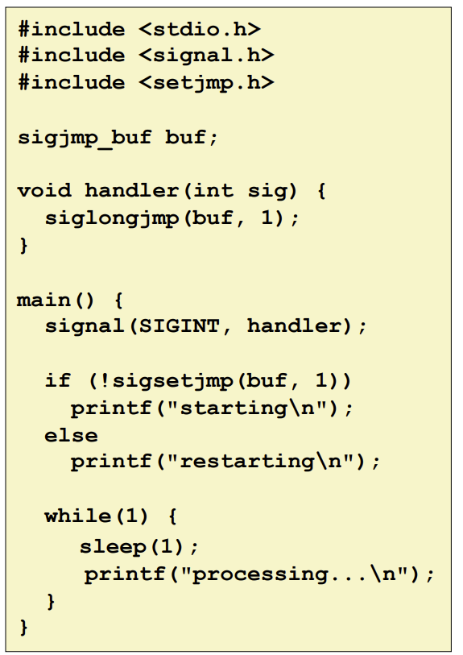
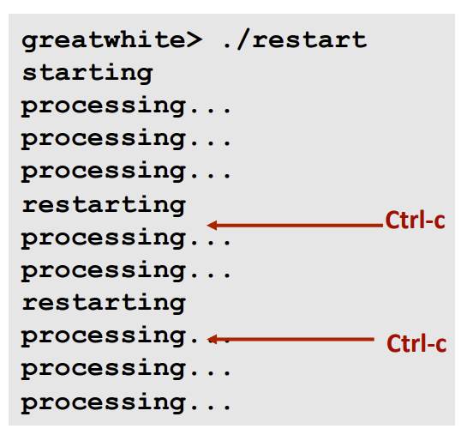
setjmp/longjmp
Nonlocal jumps provide exceptional control flow within process
Notes:
siglongjmp() is similar to longjmp(), except for the optional capability of restoring the signal mask.
The sigsetjmp()—siglongjmp() pair, the setjmp()—longjmp() pair, the _setjmp()—_longjmp() pair, and the getcontext()—setcontext() pair cannot be intermixed.
A stack environment and signal mask saved by sigsetjmp() can be restored only by siglongjmp().

Slide 14
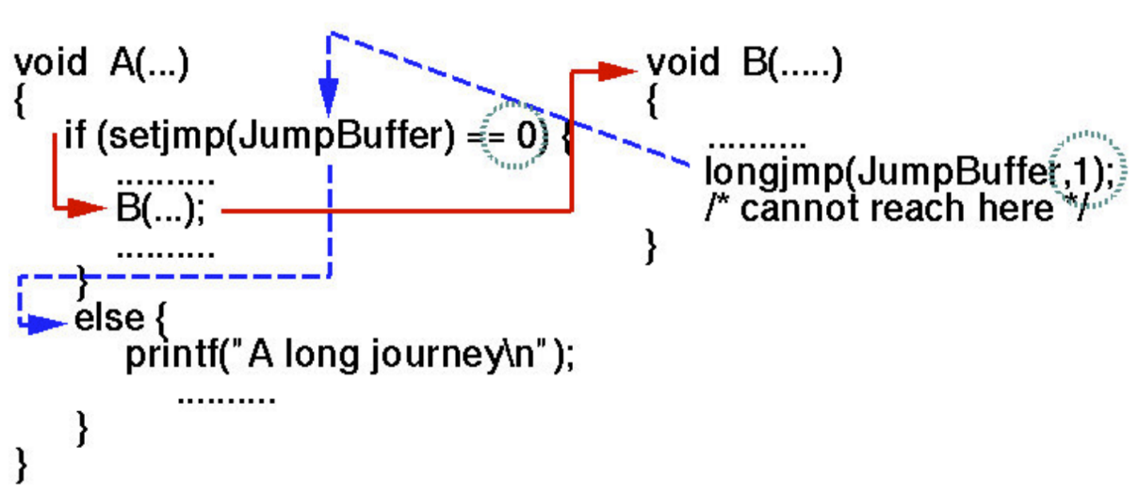
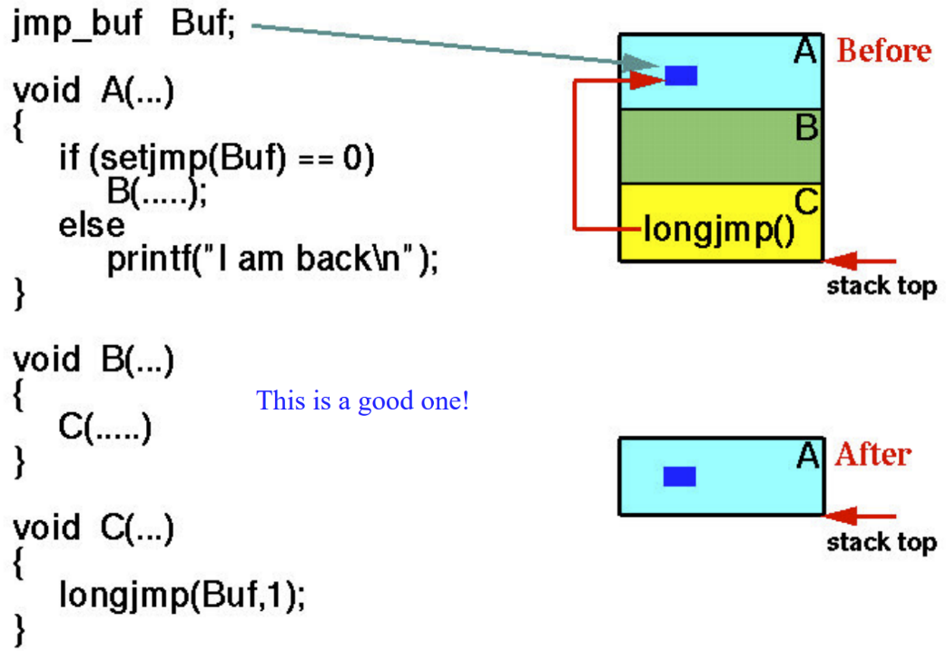
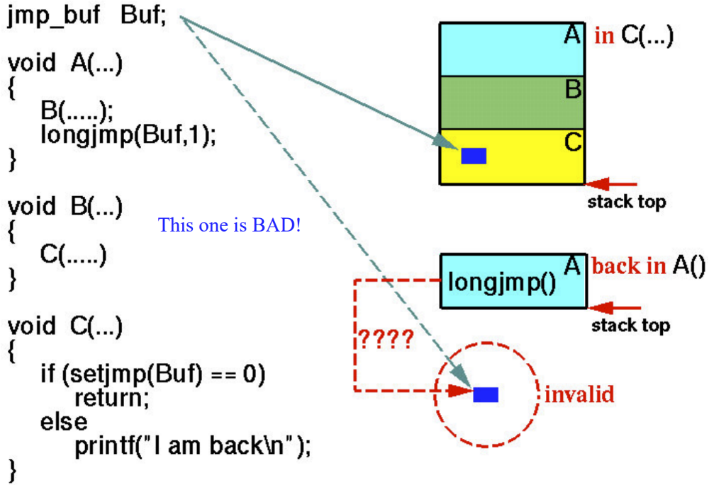
setjmp/longjmp

Slide 15
堆缓冲区利用
Compiler generated function pointers (e.g. C++ code)
After overflow of buf :
FP1
method #1
vptr
FP2
method #2
FP3
method #3
data
vtable
Object T
NOP slide
shell code
buf[256]
vtable
vptr
data
object T

Slide 16
Heap Spraying
Idea: 1. use Javascript to spray heap with shellcode (and NOP slides)
2. then point vtable ptr anywhere in spray area
NOP slide
shellcode
heap
vtable
heap spray area

Slide 17
格式化字符串漏洞
[National Vulnerability Database http://web.nvd.nist.gov/view/vuln/statistics 10 April 2017]

Slide 18
历史
2000年6月发现了第一个漏洞
实例:
wu-ftpd 2.* : remote root
Linux rpc.statd: remote root
IRIX telnetd: remote root
BSD chpass: local root
Notes:
Oct 2013: Screen Sharing Server in MacOS X before 10.9 and Apple Remote Desktop 3.5.4 allows remote attackers to execute arbitrary code via format string specifiers in a VNC username
Dec 2013: Format string vulnerability in the client in Tftpd32 before 4.50 allows remote servers to cause a denial of service (crash) or possibly execute arbitrary code via format string specifiers in the Remote File field.

Slide 19
易受攻击的函数
任何使用格式字符串的函数
Printing:
printf, fprintf, sprintf, …
vprintf, vfprintf, vsprintf, …
Logging:
syslog, err, warn

Slide 20
格式化函数执行
printf ("Number %d has no address, number %d has: %08x\n", i, a, &a);
From within the printf function the stack looks like this:
. . .
<&a>
<a>
<i>
A
. . .
where:
A – 被格式化字符串的地址
i – 变量i的值
a – 变量a的值
&a – 变量a的地址
函数printf通过一次读取一个字符来解析字符串'A'
如果字符前没有’%'，则将该字符复制到输出
如果字符前有%，‘%’后面的字符指定输出参数的类型；该参数位于堆栈上
Notes:
Functionality
used to convert simple C datatypes to a string representation
allow to specify the format of the representation
process the resulting string (output to stderr, stdout, syslog, ...)
How the format function works
the format string controls the behaviour of the function
it specifies the type of parameters that should be printed
parameters are saved on the stack (pushed)
saved either directly (by value), or indirectly (by reference)
The calling function
has to know how many parameters it pushes to the stack, since it has to do the stack correction, when the format function returns

Slide 21
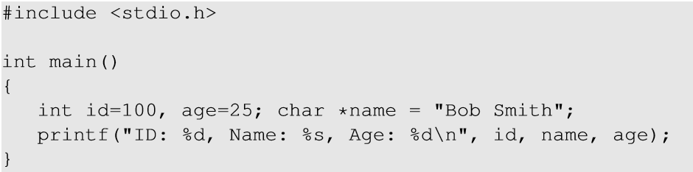
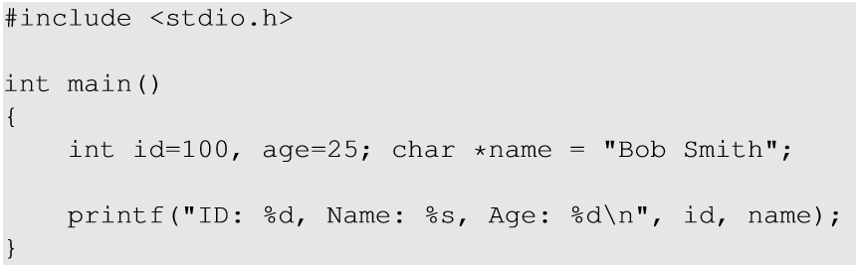
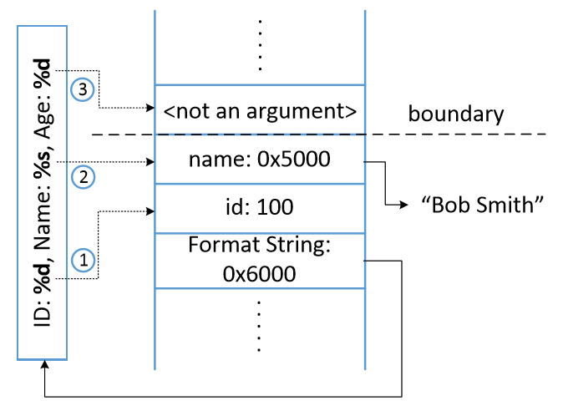
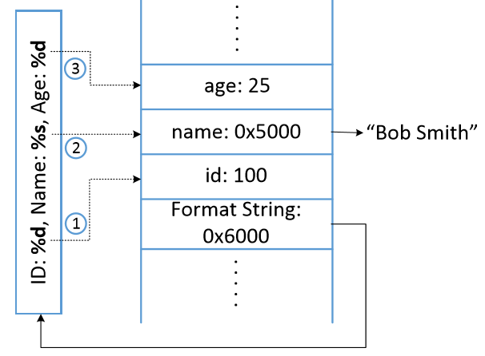

Slide 22
DoS 攻击
int func(char *user) {
fprintf( stdout, user);}
问题: 如果 user = “%s%s%s%s%s%s%s”
程序很可能会崩溃
为什么?
％s将尝试从堆栈中提供的地址显示该地址内存中的数据; 这个地址很可能这是一个非法地址
正确的使用方法:
int func(char *user) {
fprintf( stdout, “%s”, user);}

Slide 23
查看栈中数据
… printf(user) …
问题: 如果 user = “%08x.%08x.%08x.%08x\n”?
从堆栈中获取4个参数，并将其显示为8位填充的十六进制数字
栈数据泄露的后果？

Slide 24
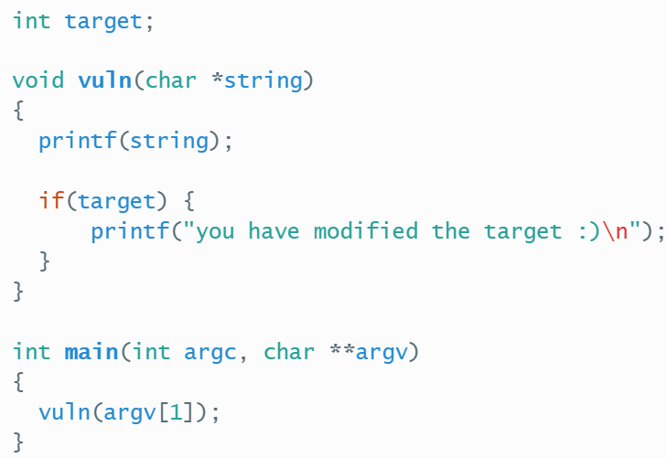
修改栈中数据
printf(“Modify the memory: %n \n”, &val);

Slide 25
使用格式化字符串的缓冲区溢出
char outbuf[512], errmsg[512];
sprintf (errmsg, “Err Wrong command: %.400s”, user);
sprintf( outbuf, errmsg );
假设 user = “%497d \x3c\xd3\xff\xbf <nops> <shellcode>”?
绕过 “%400s”的限制
outbuf溢出，实现常规栈缓冲区溢出攻击
QPOP 2.53 bftpd
问题：NOP的作用？
https://crypto.stanford.edu/cs155old/cs155-spring08/papers/formatstring-1.2.pdf

Slide 26
格式化字符串说明符
%p, %s, %d, %x，%n
位置参数(positional argument)
%[nth]$p
%2$p = 第二个参数
printf(“%2$d”, 10, 20, 30) ---> 20
%n
printf("1234%n", &len) => len=4
%10d
Notes:
%p在C语言中是一个格式占位符，它表示以十六进制形式输出一个指针的地址
%n是一个格式化输出的转换说明符，用于将已经输出的字符数保存到一个整数变量中

Slide 27
任意读
printf(“\xaa\xbb\xcc\xdd%3$s”, a1, a2)
+---(3rd)---+
| v
[ra][fmt][a1][a2][\xaa\xbb\xcc\xdd%3$s]
(1) (2) (3) ....
(1)(2) (3)
=> printf(“...%3$s”, a1, a2, 0xddccbbaa)

Slide 28
写任意位置
printf(“\xaa\xbb\xcc\xdd%3$n”, a1, a2)
+---(3rd)---+
| v
[ra][fmt][a1][a2][\xaa\xbb\xcc\xdd%3$n]
(1) (2) (3) ....
*0xddccbbaa = 4

Slide 29
任意写
printf(“\xaa\xbb\xcc\xdd%6c%3$n”, a1, a2)
+---(3rd)---+
| v
[ra][fmt][a1][a2][\xaa\xbb\xcc\xdd%6c%3$n]
(1) (2) (3) ....
=> *0xddccbbaa = strlen("\xaa\xbb\xcc\xdd......") = 10
https://crypto.stanford.edu/cs155old/cs155-spring08/papers/formatstring-1.2.pdf

Slide 30
任意写
unsigned char canary[5];
unsigned char foo[4];
memset (foo, ’\x00’, sizeof (foo));
strcpy (canary, "AAAA"); /* 0 * before */
printf ("%16u%n", 7350, (int *) &foo[0]); /* 1 */
printf ("%32u%n", 7350, (int *) &foo[1]); /* 2 */
printf ("%64u%n", 7350, (int *) &foo[2]); /* 3 */
printf ("%128u%n", 7350, (int *) &foo[3]); /* 4 */
printf ("%02x%02x%02x%02x\n", foo[0], foo[1], foo[2], foo[3]); /* 5 * after */
printf ("canary: %02x%02x%02x%02x\n", canary[0], canary[1], canary[2], canary[3]);
foo: 10204080

Slide 31
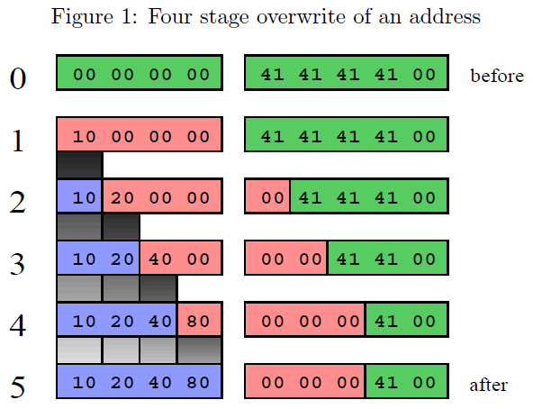
任意写

Slide 32
格式化字符串漏洞
任意读：代码指针泄露
任意写：控制流劫持
可以绕过：DEP(W^X), ASLR

Slide 33
堆溢出举例
#define BUFSIZE 16
int main()
{ int i=0;
char *buf1 = (char *)malloc(BUFSIZE);
char *buf2 = (char *)malloc(BUFSIZE);
:
while((*(buf1+i)=getchar())!=EOF)
i++;
:
}
Sensitive data
buf2
buf1

Slide 34
BSS 溢出举例
\0
p
m
t
.
g
..
P
m
t
/
#define BUFSIZE 16
int main(int argc, char **argv)
{ FILE *tmpfd;
static char buf[BUFSIZE], char *tmpfile;
:
tmpfile = "/tmp/vulprog.tmp";
gets(buf);
tmpfd = fopen(tmpfile, "w");
:
}
0x200
\0
d
w
s
s
a
p
/
c
t
e
/
0x100
tmpfile
0x100
0x200
^{buf}
Notes:
BSS段通常是指用来存放程序中未初始化的或者初始化为0的全局变量和静态变量的一块内存区域。特点是可读写的，在程序执行之前BSS段会自动清0。

Slide 35
BSS 溢出举例
int goodfunc(const char *str);
int main(int argc, char **argv)
{ int i=0;
static char buf[BUFSIZE];
static int (*funcptr)(const char *str);
:
while((*(buf+i)=getchar())!=EOF)
i++;
:
}

Slide 36
大纲
控制流劫持攻击
防御方法简介
Return to libc及ROP
控制流完整性（CFI）

Slide 37
防御控制流劫持攻击
Fix bugs:
软件审查
代码静态分析工具: Coverity, Prefast/Prefix, Fortify …
使用类型安全的语言重写软件 (Java, ML)
重写现有（遗留）软件比较困难
允许溢出，防止shellcode执行
NX位
添加运行时检查代码，检测溢出利用
当检测到进程被攻击者用溢出漏洞攻击时挂起该进程
StackGuard, PointGuard, LibSafe, …
Notes:
https://bbs.pediy.com/thread-226696.htm

Slide 38
防御控制流劫持攻击
较少攻击者进行缓冲区溢出的机会:
独立的控制栈，Separate control stack
随机化
ASLR (Address Space Layout Randomization)
控制流完整性，Control flow integrity (CFI)

Slide 39
Linux进程内存布局
0xC0000000
user stack
%esp
shared libraries
0x40000000
brk
run time heap
Loaded from exec
0x08048000
unused
0

Slide 40
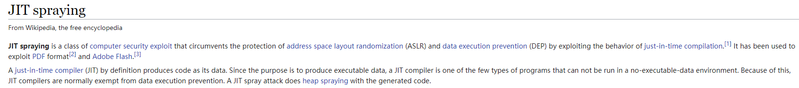
将内存标记为不可执行(W^X)
通过将栈和堆段内存标记为不可执行，来防止溢出代码执行
AMD Athlon 64 的NX-bit, Intel P4 Prescott 的XD-bit
每一个Page Table Entry (PTE)都有NX位
系统部署:
Linux PaX项目
Windows XP SP2开始加入DEP(data execute prevention)机制
优点:无需修改或重新编译
缺点：
需要硬件支持
一些程序需要堆内存可执行(e.g., JITs)
W^X不能防御return-to-libc/ROP攻击
https://en.wikipedia.org/wiki/JIT_spraying
Notes:
OptIn: Windows processes are protected. Other apps must OptIn for protection using sysdm.cpl program.
DEP: data execute prevention

Slide 41
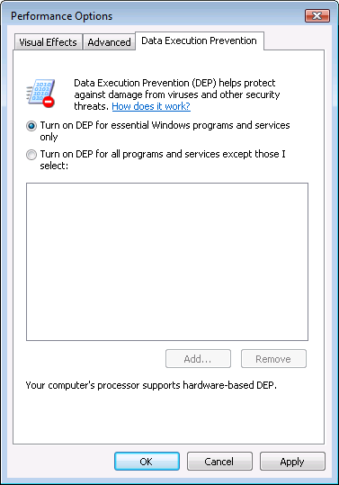
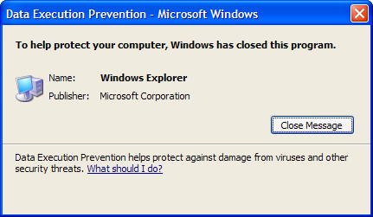
Vista中的DEP控件
DEP终止了一个程序

Slide 42
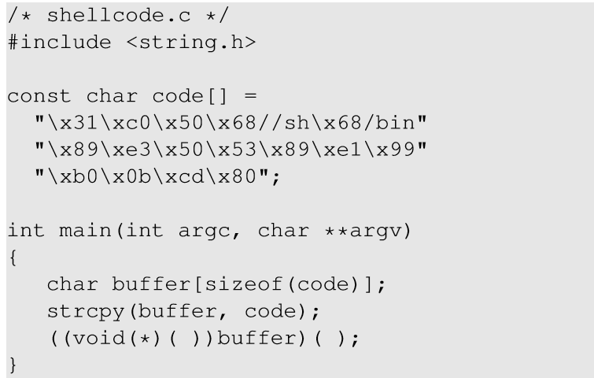
Non-executable 栈
在C 程序中运行shellcode
调用shellcode
Notes:
Consider the above code that places a shellcode in a buffer on the stack, casts the buffer as a function and calls the function.

Slide 43
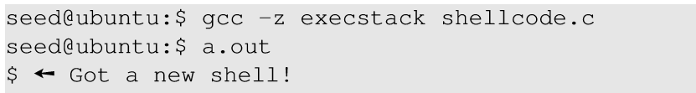
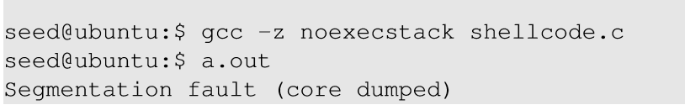
Non-executable 栈
使用可执行栈
使用不可执行栈
Notes:
title

Slide 44
运行时检查: StackGuard
许多运行时检查技术 …
方案 1: StackGuard
运行时检测栈的完整性
在栈帧中嵌入“canaries”，在函数返回前校验“canaries”是否被改变，从而保证栈的完整性
Frame 2
Frame 1
local
canary
sfp
ret
str
local
canary
sfp
ret
str

Slide 45
Canary 类型
随机的 canary:
程序启动时选择一个随机的字符串（canary）
每一个栈中插入一个 “canary”
函数返回前检查canary是否被破坏（覆盖）
Terminator canary: Canary = 0, newline, linefeed, EOF
字符串函数不会复制超出终止符的内容
攻击者无法使用字符串函数来破坏堆栈

Slide 46
StackGuard (cont.)
StackGuard实现为GCC补丁
程序必须被重新编译
GCC: -fstack-protector, -fstack-protector-strong
优点: 无需改变代码，只需要重新编译
缺点：
性能损失，如：Apache httpd额外开销为8%
只能针对stack smashing进行保护
基于secret，如果attacker可以读取memory，将会失败
Notes:
Note: Canaries don’t offer full proof protection.
Some stack smashing attacks leave canaries unchanged

Slide 47
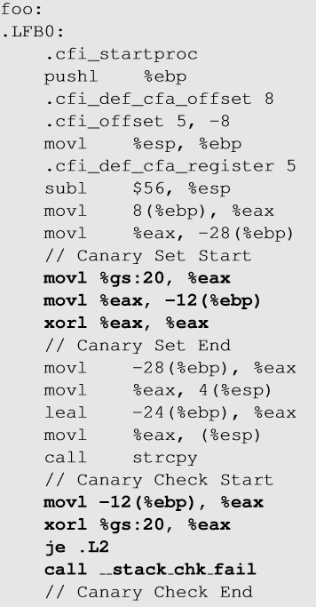
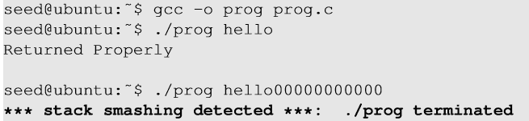
Execution with StackGuard
Canary check done by compiler.
Notes:
Prog.c is a vulnerable program which takes input from the user and calls a function foo() which copies to a buffer. When the user passes a variable of longer length than buffer size, it changes the value of the local variable (guard) and hence, the program terminates with stack smashing message.

Slide 48
StackShield
StackShield
函数调用前，将返回地址RET和ebp复制到“安全”位置
函数返回前，恢复保存的RET和ebp
实现为GCC的扩展

Slide 49
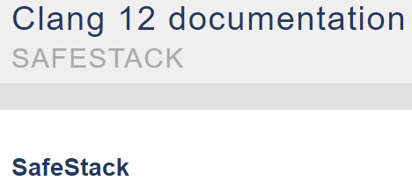
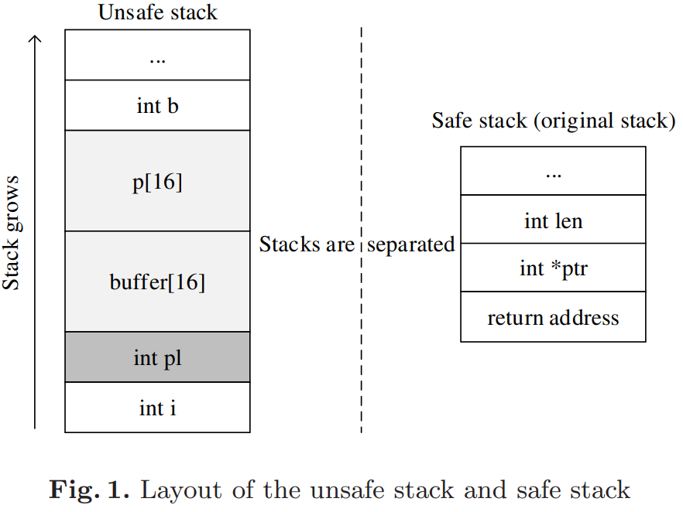
Separate Stack
https://clang.llvm.org/docs/SafeStack.html
clang-3.7 -fsanitize=safe-stack -o a.out test.c
“SafeStack is an instrumentation pass that protects programs against attacks based on stack buffer overflows, without introducing any measurable performance overhead.
It works by separating the program stack into two distinct regions: the safe stack and the unsafe stack.
The safe stack stores return addresses, register spills, and local variables that are always accessed in a safe way, while the unsafe stack stores everything else.
This separation ensures that buffer overflows on the unsafe stack cannot be used to overwrite anything on the safe stack.”

Slide 50
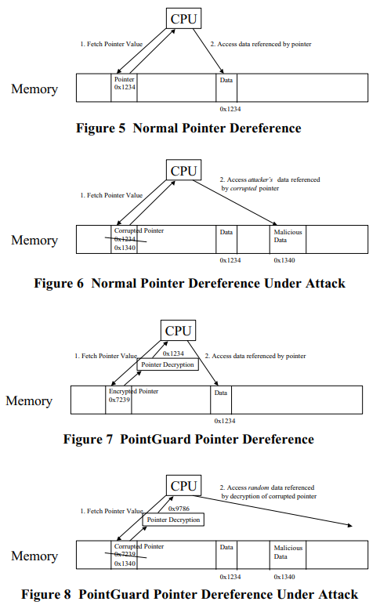
PointGuard
PointGuard
对指针进行加密
在指针加载到寄存器时进行解密

Slide 51
随机化
ASLR (Address Space Layout Randomization)
将共享库映射到进程内存中的随机位置
⇒攻击者不能直接跳转到exec函数
Deployment:
Windows Vista (2007): 8 bits of randomness for DLLs
Linux (via PaX): 16 bits of randomness for libraries
kernel 2.6.12 ， 2005
ASLR在64位的系统使用更有效
其他随机化方法:
系统调用随机化: 随机化系统调用的ID
指令集合随机化 (ISR)
Notes:
Combination of NX and ASLR is effective.

Slide 52
ASLR - Overview
stack seg.
stack seg.
libraries
stack seg.
libraries
heap seg.
libraries
heap seg.
heap seg.
data seg.
data seg.
code seg.
data seg.
code seg.
code seg.

Slide 53
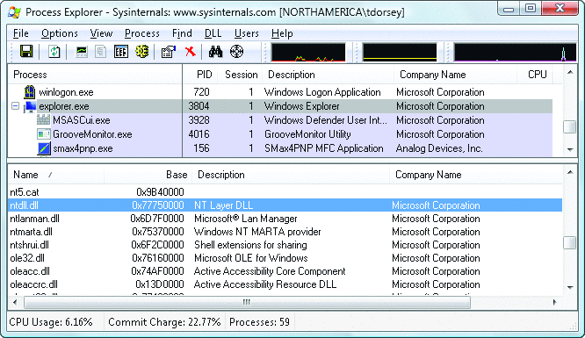
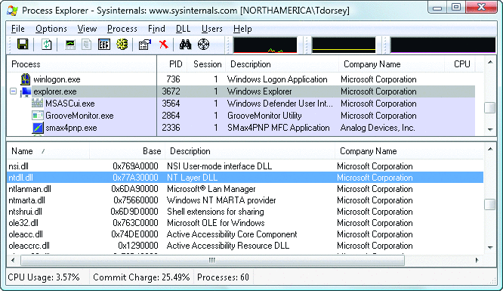
ASLR 实例
两次启动Vista，系统将动态链接库加载到内存不同的位置

Slide 54
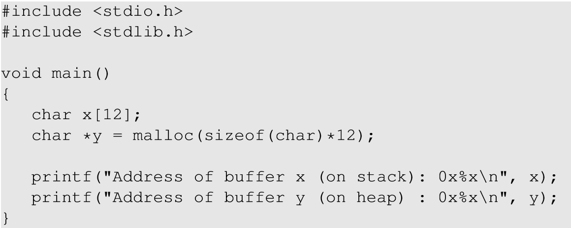
ASLR 实例
Notes:
When the ASLR is enabled in the Linux machine, we ran the above code to check how it affects the addresses of the local variables on stack as well as heap. ASLR changes the address of the code every time it is loaded.

Slide 55
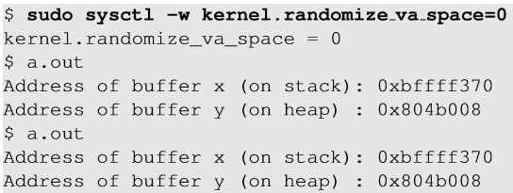
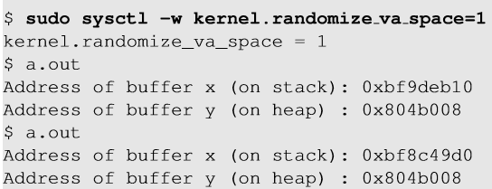
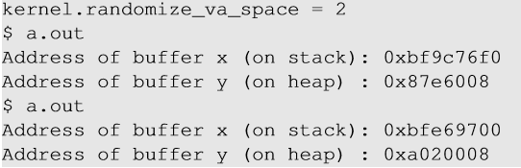
ASLR 实例
1
2
3
cat /proc/sys/kernel/randomize_va_space
Notes:
1 : When set to 0, the address space is not randomized.
2 : When set to 1, only stack memory address is randomized.
3 : When set to 2, both stack and heap memory address is randomized.

Slide 56
ASLR
优点: 无需改变代码，无需重新编译
缺点：
32位架构的保护有限
基于secret，如果attacker可以读取memory，将会失败
性能损失

Slide 57
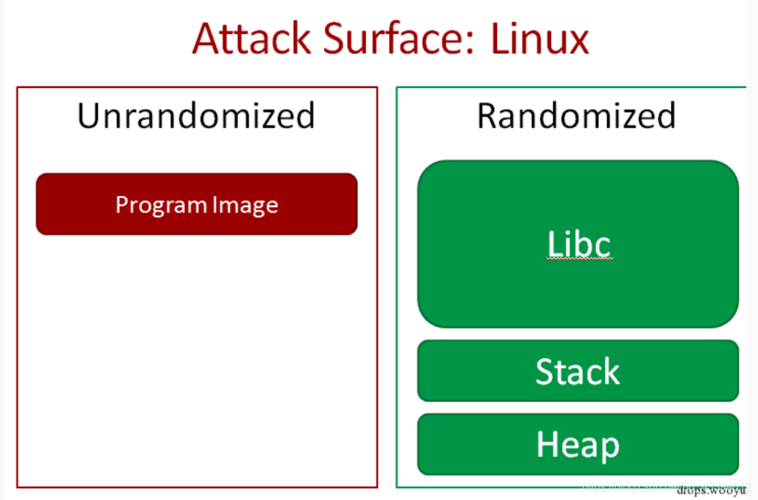
ASLR, PIE, PIC
ASLR
PIE
position independent executable
PIC
position independent code
Notes:
PIE:用在可执行文件
PIC:用在库文件

Slide 58
PIE
#include <stdlib.h>
#include <stdio.h>
void *getEIP() {
return __builtin_return_address(0)-0x5;
}
int main(int argc, char** argv) {
printf("EIP located at: %p\n", getEIP());
return 0;
}
gcc -fPIE
http://www.openbsd.org/papers/nycbsdcon08-pie/mgp00001.html

Slide 59
绕过 ASLR
Brute force
内存泄露，GOT/PLT

Slide 60
Brute force问题
32位Linux系统：
栈，19 bits，地址空间2¹⁹ = 524288
Brute force方法

Slide 61
Brute force
1. 打开地址随机化
% sudo sysctl -w kernel.randomize_va_space=2
2. 编译
% gcc -o stack -z execstack -fno-stack-protector stack.c

Slide 62
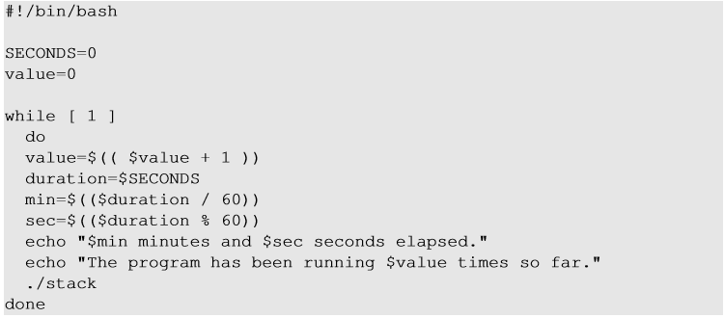
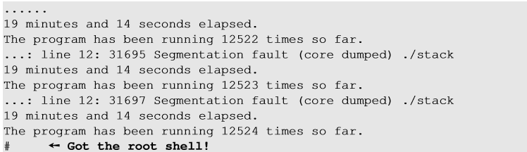
Brute force
3. 运行多次vulnerable程序： source aslr_defeat.sh

Slide 63
GOT/PLT
int main() {
printf("This is the first call!\n");
printf("This is the second call!\n");
exit(0);
return 1;
}
Procedure Linkage Table
Global Offset Table

Slide 64
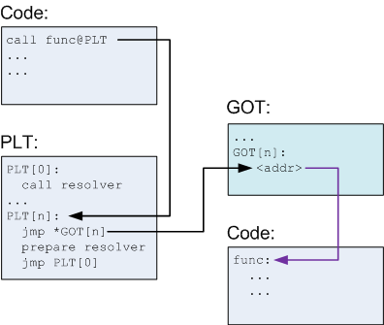
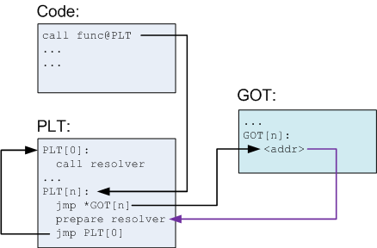
GOT/PLT
解析前
解析后
The Global Offset Table (or GOT) is a section inside of programs that holds addresses of functions that are dynamically linked.
Before a functions address has been resolved, the GOT points to an entry in the Procedure Linkage Table (PLT).
This is a small "stub" function which is responsible for calling the dynamic linker with (effectively) the name of the function that should be resolved.
https://nuc13us.wordpress.com/2015/12/25/hack-using-global-offset-table/

Slide 65
GOT/PLT
int main()
{
exit(printf(“Hello, World\n”));
}
0x80482be <printf@plt+6>: push $0x10
0x80482c3 <printf@plt+11>: jmp 0x8048288
0x8048288: pushl 0x80495a8
0x804828e: jmp *0x80495ac
0x80495ac <_GLOBAL_OFFSET_TABLE_+8>: 0x003874c0
0x3874c0 <_dl_runtime_resolve>: push %eax
0x080483cc <main+24>: call 0x80482b8 <printf@plt>
0x80482b8 <printf@plt>: jmp *0x80495b8
0x80495b8 <_GLOBAL_OFFSET_TABLE_+20>: 0x00146e10
0x80495b8 <_GLOBAL_OFFSET_TABLE_+20>: 0x080482be
0x146e10 <printf>: push %ebp
Function name | Address in libc
printf() | 0x00146e10
exit() | 0x00147f23

Slide 66
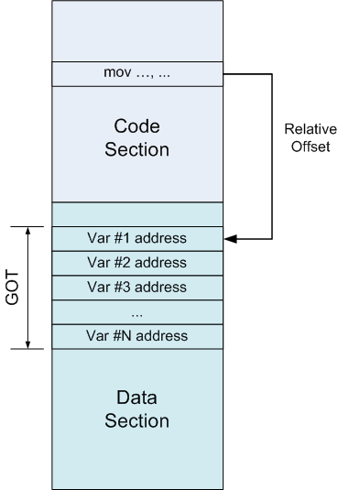
GOT
问题？
write -> 控制流劫持
read -> 内存泄露

Slide 67
内存泄露
PLT/GOT，延迟绑定
开启ASLR
library地址变化：基地址变化，相对位置不变
Executable地址不变（no pie情况下）
泄露lib基地址，即可以绕过ASLR，调用相应的函数（ret2libc）

Slide 68
内存泄露
PIE
泄露代码段(text)基址
Partial (EIP) Overwrite

Slide 69
Control Flow Integrity
检查每一个间接跳转
函数返回
函数指针
虚拟方法
优点：
无需修改代码
更多的漏洞利用保护
缺点：
性能损失
需要更好的编译器
需要所有的代码

Slide 70
大纲
控制流劫持攻击
防御方法简介
Return to libc及ROP
控制流完整性（CFI）

Slide 71
Return to libc
劫持控制流使控制流指向libc中的系统函数，因此不需要插入shellcode代码
stack
libc.so
args
攻击者不能执行插入到数据段的代码
攻击者基于libc中的代码片段进行攻击
ret-addr
exec()
sfp
printf()
local buf
“/bin/sh”
Notes:
NX wasted effort?
A return-to-libc attack is a computer security attack usually starting with a buffer overflow in which the return statement on the stack is replaced by the address of another instruction and an additional portion of the stack is overwritten to provide arguments to this function. This allows attackers to call preexisting functions without the need to inject malicious code into a program.
The shared library called "libc" provides the C runtime on UNIX style systems. Although the attacker could make the code return anywhere, libc is the most likely target, as it is always linked to the program, and it provides useful calls for an attacker (such as the system() call to execute an arbitrary program, which needs only one argument). This is why the exploit is called "return-to-libc" even when the return address may point to a completely different location.

Slide 72
Return to libc攻击概述
Task A : 查找 system()的地址
用system() 的地址覆盖返回地址
Task B : 查找 “/bin/sh” 字符串的地址
从system()运行命令“/bin/sh”
Task C : 为system()构造参数
在栈中查找位置以放置“/bin/sh” 地址（system()的参数）

Slide 73
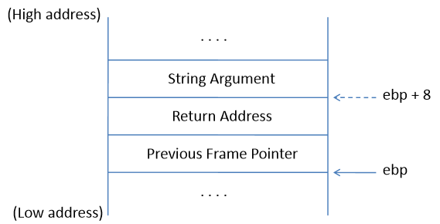
Task C : system()的参数
system()的参数需要放在栈上
与ebp的相对位置，可以用作参数访问
在ret到system() 之后，需要知道ebp的确切位置，这样可以将参数放在ebp + 8
system() 函数的栈帧

Slide 74
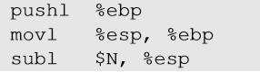
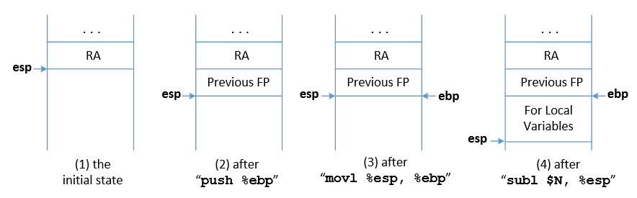
Task C : system()的参数
Function Prologue
esp : Stack pointer
ebp : Frame Pointer
Notes:
The start of the function call contains 3 instructions as mentioned.
When a function is called, return address (RA) is pushed into the stack. This is the beginning of the function before function prologue gets executed. The stack pointer (esp register) points at RA location.
The previous frame pointer is pushed in the stack, so when the function returns, the caller’s frame pointer is recovered.
The stack pointer now points to the previous frame pointer. The frame pointer (ebp) is pointed to the current stack pointer now so that the frame pointer always points to the old frame pointer.
The stack pointer now moves by N bytes to leave space for the local variables of the function.

Slide 75
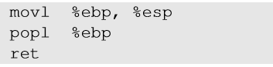
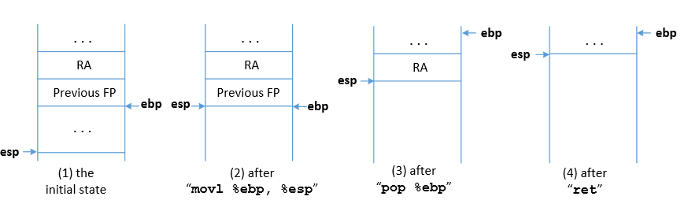
Task C : system()的参数
Function Epilogue
esp : Stack pointer
ebp : Frame Pointer
Notes:
The stack pointer now points where the frame pointer points to in order to release the stack space allocated for the local variables.
The previous frame pointer is assigned to %ebp to recover the frame pointer of the caller’s function.
The return address is popped from the stack and the program jumps to that address. This instruction moves the stack pointer.

Slide 76
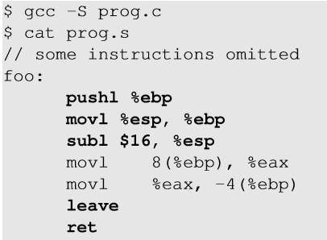
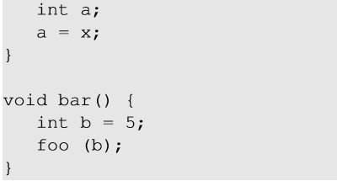
Function Prologue 和Epilogue 举例
1
Function prologue
Function epilogue
2
1
2
8(%ebp) ⇒ %ebp + 8
Notes:
The code can be compiled into assembly code using gcc -s.

Slide 77
如何查找system()的参数地址?
Change ebp and esp
Modified Return Address
vul_func() epilogue
system() prologue
Use of system()’s argument
为了找到system() 参数，我们需要了解ebp和esp寄存器如何随函数调用而改变
在返回地址被修改和使用系统参数之间，vul_func() 返回并且system() 序言开始

Slide 78
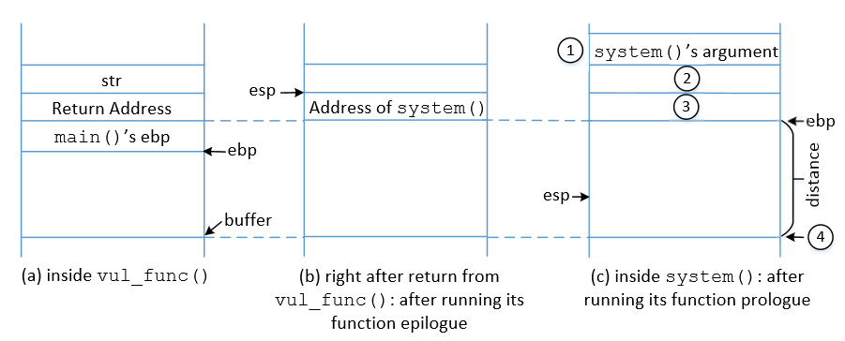
理解system()参数

Slide 79
理解system()参数
Return address is changed to system() address
ebp is replaced by esp after vul_func() epilogue
Jump to system()
“/bin/sh” is stored in ebp+8
ebp is set to current value of esp
system() prologue is executed
Check the memory map
ebp + 4被视为 system()的返回地址。
可以将 exit()函数的地址放置于此，以便在 system() 返回时exit()被调用 ，从而程序不会崩溃

Slide 80
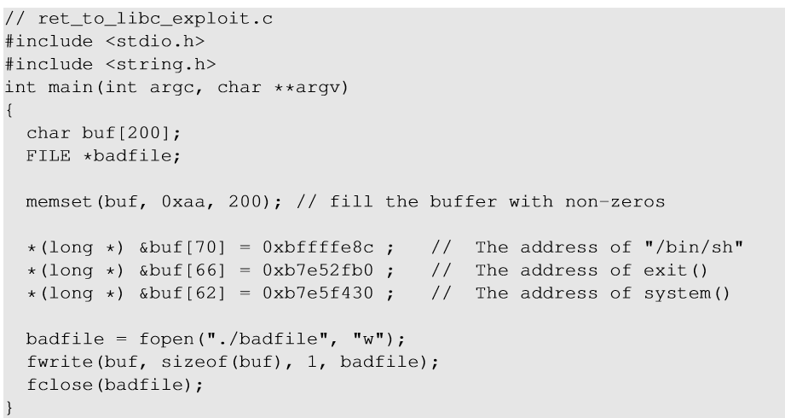
恶意代码
ebp + 12
ebp + 8
ebp + 4
Vul_func的ebp
Notes:
我们在易受攻击的函数内部（在返回之前），所以ebp当前指向易受攻击函数的stack frame。

Slide 81
Ret2lic: 多函数调用
system(/bin/sh) + exit(?)
两个函数:
printf(“Password OK”）
system("/bin/sh")
[arg1 ] ----> "/bin/sh
[old-arg1 ] ----> 1) "Password OK“
[ra ] -------------------> 2) system
[old-ra ] ----> 1) printf
[..... ]
[buf ]

Slide 82
Ret2lic: 多函数调用
多个(>=3)函数?
printf("Password OK") system("/bin/sh")
exit(0)
open("/proc/flag", O_RDONLY) read(3, tmp, 1024)
write(1, tmp, 1024)

Slide 83
Ret2lic: 多函数调用
[arg1 ] ----> 0
[ra ] ...
[ra ] ----> 3) exit
[arg1 ] ----> "/bin/sh“
[ra ] -------------------> pop/ret gadget
[ra ] ----> 2) system
[old-arg1 ] ----> "Password OK"
[ra ] -------------------> pop/ret gadget
[old-ra ] ----> 1) printf
[..... ]
[buf ]

Slide 84
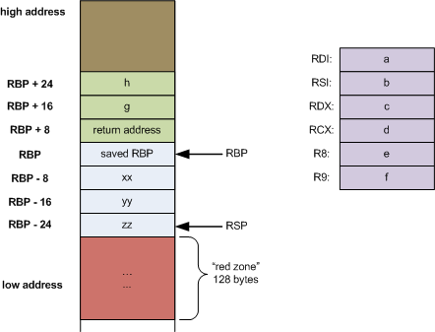
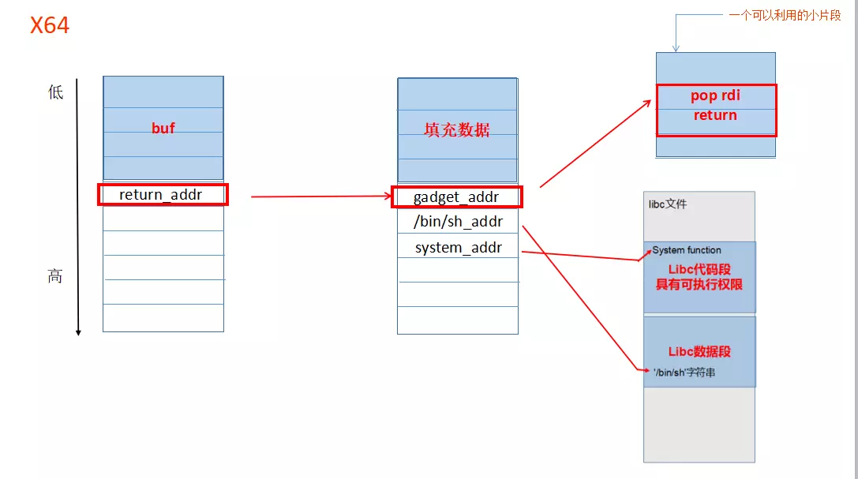
Ret2lic: 多函数调用
pop的作用?
64位下如何操作?
long myfunc(long a, long b, long c, long d, long e, long f, long g, long h)
pop rdi
https://www.ired.team/miscellaneous-reversing-forensics/windows-kernel-internals/linux-x64-calling-convention-stack-frame
Notes:
https://man7.org/linux/man-pages/man2/syscall.2.html

Slide 85
The Return-oriented programming
足够大的程序代码
执行任意的攻击计算和行为，
不需要注入代码
(防御: control-flow integrity)
[Shacham 2007 for x86]

Slide 86
Return-oriented programming
提出:
The Geometry of Innocent Flesh on the Bone: Return-into-libc without Function Calls (on the x86), CCS’07
思想：
不直接使用libc中的函数，而是利用多个指令gadgets来实现shellcode
挑战
找到指令片段
将指令片段串联在一起

Slide 87
ROP方法
把libc看作以“ret”指令结尾的指令序列的库
使用指向这些序列的指针（和数据）填充栈
执行这些序列，产生需要的代码行为（图灵完备性）
与return to libc比较?
the stack:
libc.so:
insns … ret
data
insns … ret
insns … ret
data
insns … ret
insns … ret
(saved IP)
Notes:
Falsfies perception of return-into-libc: limited, easy to defeat
Attacker cannot execute arbitrary code
Attacker relies on contents of libc — remove system()?

Slide 88
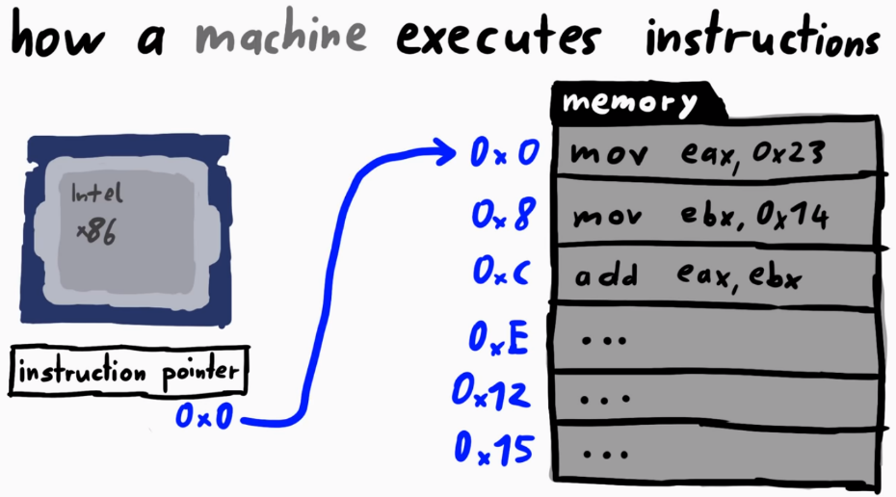
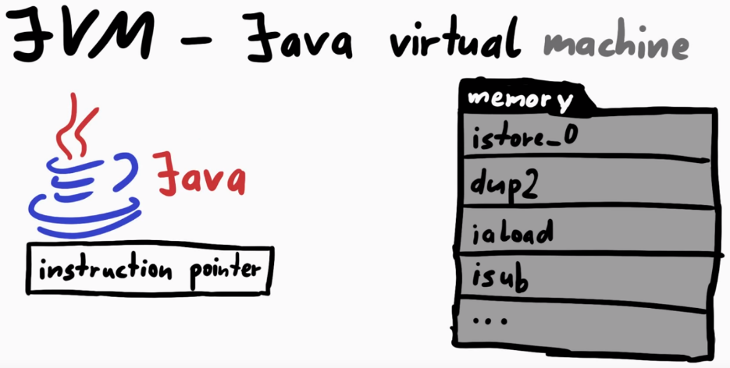
ROP方法
Gadgets是以ret指令结束的指令序列
Stack的作用
%esp = program counter，eip
Gadgets通过ret指令被调用
Gadgets通过pop等指令获得arguments

Slide 89
ret 指令
ret ≡ pop eip
:
:
0x08900000
:
ret
:
:
push %ebp
:
:
:
mov %eax, %ebx
call 0x09012000
:
esp
0x09012000
eip
0x08900000
CPU

Slide 90
Gadgets
gadget 是指任何以ret指令结尾的指令序列
Return指令有两个作用:
该指令查找堆栈顶部的四字节值，并将指令指针设置为该值。 (改变EIP)
将堆栈指针的值增加4。（改变ESP）
Notes:
Return instruction has 2 effects: (1) the instruction searches for the four-byte value at the top of the stack, and set the instruction pointer to the value. (2) it increases the stack pointer value by four.

Slide 91
使用ret进行指令序列执行
:
0x09012800
0x08900200
:
ret
:
:
ret
add $03, %eax
:
ret
mov %eax, %ecx
:
add $03, %eax
ret
mov %eax, %ecx
ret
esp
0x09012800
eip
0x08900200
CPU

Slide 92
写Registers
pop reg and ret
Ex., write to both eax and ebx
pop eax
pop ebx
ret
xchg reg, reg and ret
mov reg, reg and ret

Slide 93
写Memory
mov [reg], reg
mov [reg+xx], reg

Slide 94
System Call
execve(“/bin/sh”, NULL, NULL)
定位 int 0x80 指令
将 “/bin/sh” 的地址写入stack
mov [reg], reg
设置 register
pop reg
eax = 11, ebx = &“/bin/sh”, ecx = 0, edx = 0

Slide 95
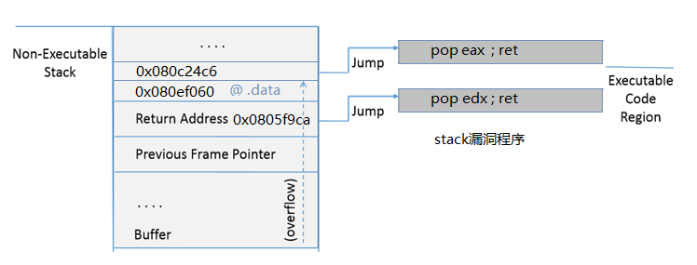
ROP方法
使用漏洞程序中的指令片段构造gadget链(用来执行shell)，并使返回地址跳转到此gadget链。
以ret结尾的指令片段称为gadget，由多个gadget链接而成的执行体称为gadget链。
把组织好的gadget的地址放入漏洞程序的栈中，使返回地址被gadget链的第一个地址覆盖。
漏洞程序函数返回时开始执行gadget链的第一条指令： “pop edx；ret”。
pop edx把下一条数据“0x080ef060”data段的地址放入edx中，esp=esp+4；
ret把0x080c24c6地址赋值给eip开始执行，即开始执行下一条gadget指令片段，esp=esp+4

Slide 96

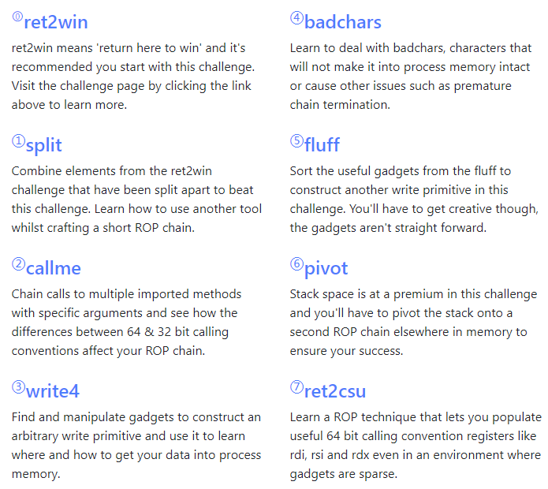
更多ROP的学习资源
https://ropemporium.com/

Slide 97
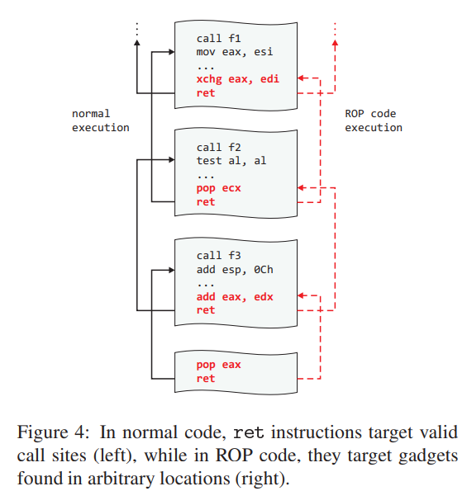
ROP的防御
ASLR
kBouncer
CFI (Control Flow Integrity )
Notes:
kBouncer基于运行时检测异常的控制传输，使用的是在普通处理器上发现的硬件特性

Slide 98
总结：控制流劫持攻击
攻击者目标:
获得目标机器的控制权, 比如服务器
通过劫持应用程序的控制流，在目标机器上执行任意的攻击代码
三种攻击实例
缓冲区溢出攻击
整数溢出攻击
格式化字符串漏洞
攻击方式：Shell code注入、ret2libc、ROP
防御方式： NX、StackGuard、ASLR

Slide 99
总结：控制流劫持攻击
防御：设置堆栈不可执行来防止代码注入攻击
攻击技术: Jump/return to libc
防御: 利用ASLR技术隐藏libc中代码地址和程序返回地址
攻击技术: 暴力破解(32-bit)或者信息泄露
防御: 编程过程中避免使用libc代码，尽量使用程序内部的代码实现
攻击技术: 利用ROP技术构造需要的函数功能

Slide 100
几点回顾
void vuln() {
char buf[256];
fgets(buf, 256, stdin);
printf(buf);
exit(1);
}
Canary
绕过方法？
read
多进程
劫持stack_chk_fail
GOT
可以利用于？
ASLR地址泄露
格式化字符串漏洞利用（任意写），实现劫持
Stack 限制
Stack pivot (迁移)
pop esp; ret
leave; ret

Slide 101
大纲
控制流劫持攻击
防御方法简介
Return to libc及ROP
控制流完整性（CFI）

Slide 102

控制流劫持
控制信息被非法篡改
Notes:
We have conducted analysis on the 107 CERT advisories from 2000 to 2003.
Our survey of the CERT advisories indicates that UCIT vulnerabilities account for 65% of advisory entries.
http://research.microsoft.com/en-us/um/people/shuochen/papers/ieee-proc.pdf
Journal version of “XKI03” in CFI slides from Princeton.

Slide 103
基于行为的检测
Stack canaries, non-executable data, ASLR的目标在于使得攻击步骤复杂化
但是这些方法仍然可能失败
基于行为的检测
观测程序的行为，即其是否按照我们的期望运行
If not，程序可能被compromised

Slide 104
Control-flow Integrity (CFI)
Challenges
定义预期行为
与预期行为的偏差
避免检测器被攻击
Solutions
控制流图Control flow graph (CFG)
内联检测器In-line reference monitor (IRM)
随机性与不变性

Slide 105
CFI的主要思想
在程序执行期间，每当一条机器指令转移控制时，通过预先构建的控制流图(CFG, Control Flow Graph)，来确定转移目标的有效性。
Notes:
Abadi et al., Control-Flow Integrity: Principles, Implementations, and Applications, TISSEC 2009.

Slide 106
基本块(Basic Block)
基本块：一个连续的指令/代码序列
任何位置的指令比其后面的所有指令先执行
没有任何外部指令可以在序列中的两个指令之间执行
1. x = y + z
2. z = t + i
1. x = y + z
2. z = t + i 3. x = y + z
4. z = t + i
5. jmp 1
3. x = y + z
4. z = t + i
5. jmp 1
6. jmp 3
Notes:
dynamic basic block (e.g., in runtime tools) All statements executed between jumps

Slide 107
基本块(Basic Block)
只有基本块开始的位置有跳转目标
只有基本块结束的位置有跳转指令
1. x = y + z
2. z = t + i
1. x = y + z
2. z = t + i 3. x = y + z
4. z = t + i
5. jmp 1
3. x = y + z
4. z = t + i
5. jmp 1
6. jmp 3

Slide 108
CFG 的定义
静态控制流图：
每一个顶点v_{i} 是一个基本块
边 (v_{i}, v_{j}) 表示从基本块 v_{i} 到基本块 v_{j}的控制转移
函数/过程内部的基本块构成intra-procedural
范围的CFG

Slide 109


调用图 Call Graph
每一个函数是一个节点，边 (v_{i}, v_{j}) 表示函数v_{i}调用函数 v_{j}
sort2
lt
sort
gt

Slide 110
控制流图 Control Flow Graph
sort2
sort
lt
gt
基于calls和returns拆解成basic blocks

Slide 111
CFI: 符合CFG定义
事先计算call/return CFG
直接文件分析或者编译分析
检测程序控制流，保证只有CFG认证的合法路径运行
直接调用(Direct Calls)、间接跳转(Indirect Calls)
只有间接调用需要被监控
jmp, call, ret (via registers)
直接调用不需要被监控
Code不变
目标地址不变

Slide 112
控制流图 Control Flow Graph
sort2
sort
lt
gt
直接调用
间接跳转(call via register, or ret)

Slide 113
内联检测器 In-line Monitor
实现内联检测器判断程序流是否安全跳转
当间接跳转时，在目标地址前插入标签
当间接跳转时，插入代码检查目标标签
标签由CFG决定

Slide 114


简单标注
sort2
sort
lt
Label L
Label L
Label L
gt
Label L
Label L
system
使用相同的label

Slide 115
详细标注
sort2
sort
lt
Label M
Label L
Label N
gt
Label L
Label M
使用不同的label
问题？
Context-insensitive vs. Context-sensitive
基于不同的调用上下文返回不同的地址

Slide 116
上下文敏感示例
void id(int z) { return z; }
a = id(4);
b = id(5);
Context-Sensitive
4
5
a = id(4);
b = id(5);
void id(int z) { return z; }
Context-Insensitive
4,5
4,5

Slide 117
CFI-步骤
目标：程序执行必须按照控制流图（CFG）的路径执行。
步骤:
静态构建CFG，比如在编译操作中
二进制插桩, 比如在软件安装时
添加ID和ID checks，维护ID的唯一性
在装载时校验CFI的插桩
确保ID和ID checks存在，ID唯一性
程序运行时对ID进行检查
间接跳转检查具有匹配的ID

Slide 118
构建 CFG
直接调用
间接调用
由于上下文不敏感CFI，导致sort调用有两个返回目标

Slide 119
二进制插桩
call 17, R: 仅当R的标签为17时，控制转移至R
在每个目的位置插入一个唯一的ID
Notes:
perhaps each instruction keeps a SET of destinations => too slow

Slide 120
插桩示例
原始汇编代码
插装后汇编代码
在二进制的目标位置插入标签“12345678”
当目标位置的标签是“12345678”时，
控制跳转到目标位置
Notes:
Prefetching in general tries to move data from main memory into the cache early, so that it's there when the program actually does reference it. If you know that 50 instructions from now you program is likely to want to access location 12345, issuing a prefetch on 12345 will likely move that data into the cache, and the processor won't stall waiting for memory at the actual instruction using the data.
The non-temporal prefetch is intended as a prefetch hint that you will use the prefetched data only once, unlike the temporal prefetches which imply that you're going to use the data repeatedly. To some extent the processor might adjust its cache management/replacement policy based on the knowledge that the data will be used once or repeatedly - exactly what happens is implementation dependent

Slide 121


插桩示例
检查目标label
检查目标label

Slide 122
校验CFI插桩
直接跳转目标(e.g., call 0x12345678)
根据CFG判断所有目标的有效性
IDs
验证每一个进入点(entry point)后是否有一个ID
验证是否有非法ID
ID checks
验证控制转移的位置前是否有ID check
验证check代码是否遵循 CFG?
Notes:
complexity is our enemy

Slide 123
安全假设
UNQ: Unique IDs
用来维护CFG的语义
NWC: Non-Writable Code（Immutable）
保证攻击者无法修改label
动态加载和动态生成的代码不满足NWC(例如JIT)
NXD: Non-Executable Data
保证攻击者无法插入具有合法label的code
Notes:
NXD – clarify attack

Slide 124

安全保证
CFI可以防护基于非法控制流转移的攻击
基于栈的缓冲区溢出攻击， ROP/return-to-libc攻击
不能防护不违反程序的原始CFG的攻击
单一标签 CFG
基于数据的攻击（data leaks or corruptions)
heartbleed
对系统调用参数的篡改
替换文件名
错误的逻辑实现

Slide 125
CFI实现
基于软件（Software-based）
硬件辅助（Hardware-assisted）

Slide 126
基于软件 vs 基于硬件的 CFI 保证
基于软件实现的控制流完整性保证
方法: 仅用软件实现控制流完整性保证
举例: Microsoft CFG, RFG; Google VTV, IFCC
优点：更快地实现/产品化，更灵活，适应各种应用场景
基于硬件实现的控制流完整性保证
方法: 使用专用硬件保证控制流完整性 (ISA 特性等)
举例: Intel CET, ARM PAC
优点：更小的性能下降，更有效地抵御攻击/绕过

Slide 127

控制流劫持
Forward-edge 控制流劫持
Backward-edge 控制流劫持

Slide 128

控制流保护 CFG (Control Flow Guard)
CFG不依赖于secret

Slide 129

返回控制流保护 RFG (Return Flow Guard)
RFG：MS的软件影子栈Software Shadow Stack
RFG依赖于secret，即shadow stack 的虚拟地址

Slide 130

返回控制流保护 RFG (Return Flow Guard)
问题：
依赖于secret，shadow stack的映射可以被成功的泄露
AnC Attack：https://www.vusec.net/projects/anc/
竞态条件，恶意的填充
https://www.techrepublic.com/article/windows-10-security-how-the-shadow-stack-will-help-to-keep-the-hackers-at-bay/

Slide 131
Google’s CFI
针对Virtual Calls的前向CFI (VTV, Virtual-Table Verification)
针对Indirect Function Calls的前向CFI (IFCC, Indirect Function-Call Checks)
https://clang.llvm.org/docs/ControlFlowIntegrityDesign.html

Slide 132

VTV

Slide 133


VTV

Slide 134

VTV

Slide 135
IFCC
通过为间接调用目标生成跳转表(jump table);
并在间接调用点添加代码来转换跳转的函数指针,这些跳转指针指向跳转表条目;
任何未指向相应表的函数指针都被视为CFI违规;

Slide 136
IFCC
所有跳转函数的地址都被替换为跳转表项的地址
每一个跳转表项实现为jump指令，跳转 到原始函数地址处.
间接调用的指针被指向正确的跳转表项处
指针转换使用跳转表基址和一个特殊的掩码来保证每次调用进入正确的跳转表
掩码取决于跳转表及其表项的大小:例如，如果跳转表大小为32个表项，每个表项为4字节，则掩码为1111100。
简单的转化格式: Pointer = ((Pointer - BaseAddress) & Mask ) + BaseAddress;
如果指针已经在跳转表项中，则保持不变。如果没有，它将被强行放入表中。

Slide 137
IFCC
Function | Address
Func_a | 1101110
Func_b | 1110010
Function | Address
Func_a | 1001111
Func_b | 1010011
FuncPtr fp;
…
fp = 1101110;
…
call fp;
…
// fp is hacked
fp = 1111110;
…
call fp;
FuncPtr fp;
…
//address replaced
fp = 1001111;
…
// transformation
fp = fp – 1000011; // 0001100
fp = fp & 1111100; // 0001100
fp = fp + 1000011; // 1001111
call fp;
fp = fp – 1000011; // 0111011
fp = fp & 1111100 ; // 0111000
fp = fp + 1000011; // 1111011
call fp; // forced to jump table
Jump Table
Base Address = 1000011
Entry size = 4 bytes
Mask = 1111100
Entry Address
1000011 + 00000
1000011 + 00100
1000011 + 01000
1000011 + 01100
1000011 + 10000
1000011 + 10100
1000011 + 11000
1000011 + 11100
jmp to crash
jmp to crash
jmp to crash
jmp to 1101110 (Func_a)
jmp to 1110010 (Func_b)
jmp to crash
jmp to crash
jmp to crash
…

Slide 138


IFCC

Slide 139


IFCC

Slide 140
Intel CET
两个部分：
影子栈Shadow Stack (SHSTK)
间接分支跟踪Indirect Branch Tracking (IBT)

Slide 141


Intel CET (Control-flow Enforcement Technology)
https://software.intel.com/sites/default/files/managed/4d/2a/control-flow-enforcement-technology-preview.pdf
Notes:
https://www.zdnet.com/article/intel-brings-novel-cet-technology-to-tiger-lake-mobile-cpus/

Slide 142

影子栈Shadow Stack
解决性能和安全问题
ssp (shadow stack pointer)
call 和 ret 自动更新 esp和ssp
无法手动更新shadow stack

Slide 143

间接分支跟踪 Indirect Branch Tracking (IBT)
所有的间接分支必须以ENDBR开始

Slide 144
CET 指令
RDSSP –读影子栈指针
INCSSP –影子栈展开
RSTORSSP, SAVEPREVSSP –影子栈上下文转化
SETSSBSY, CLRSSBSY –标记影子栈在使用中
ENDBR, No-Track – 间接分支跟踪

Slide 145
Intel CET
CET 支持
Glibc: https://man7.org/linux/man-pages/man1/gcc.1.html
Microsoft: Hardware-enforced Stack Protection, https://www.zdnet.com/article/microsoft-announces-new-hardware-enforced-stack-protection-feature/

Slide 146

Microsoft: 基于硬件实现的栈保护
Notes:
https://techcommunity.microsoft.com/t5/windows-kernel-internals/understanding-hardware-enforced-stack-protection/ba-p/1247815

Slide 147


Microsoft: 基于硬件实现的栈保护
ROP问题
影子栈
每条CALL指令上，返回地址都被压入栈和影子栈上；而在RET指令上，进行比较以确保完整性不受影响。

Slide 148
ARM 8.3-A Pointer Authentication
64-bit pointer
指针认证代码Pointer Authentication Codes (PAC)
填充在虚拟地址中未使用的部分
在更高的特权级配置
需要插入PAC处理指令
操作码决定使用的密钥
操作码设置PA modifier (调整值)
address
modifier
tweakable MAC
PA-key
PAC
PAC
address
instructions | Code-key |  | Data-key |  | Gen.-key
 | A | B | A | B
pacia | X
pacib |  | X
pacda |  |  | X
pacdb |  |  |  | X
pacga |  |  |  |  | X
autia | X
autib |  | X
autda |  |  | X
autdb |  |  |  | X

Slide 149


Example: 利用PA保护return address
autia LR, SP
LR address
pacia LR, SP
func {
str LR
…
…
ldr LR
ret
}
Function return address
generate PAC
Code Key A
STACK
PAC
PAC
LR address
PAC?
PAC?
LR address
verify PAC
PI
Code Key A
https://www.usenix.org/system/files/sec21summer_liljestrand.pdf
Qualcomm “Pointer Authentication on ARMv8.3”, whitepaper 2017
Notes:
https://www.qualcomm.com/media/documents/files/whitepaper-pointer-authentication-on-armv8-3.pdf

